Slide 1
Digital Image Fundamentals

Slide 2
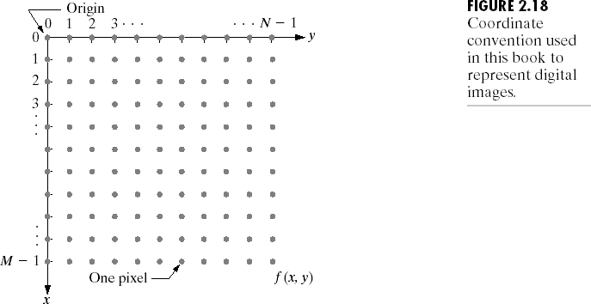
Digital Image Representation
A digital Image is an image f(x,y) that has been discretized both in spatial coordinates and brightness value.
The elements of the digital array are called image elements, picture elements, pixels or pels

Slide 3
Digital Image Representation
The resulting sampled and quantized image is a matrix of
numbers having M rows and N columns.
NOTE: By convention in image representation the indices of the matrix are represented using integer values.
The range of values spanned by the gray scale is called the
dynamic range of the image usually expressed as [0, L].
The number gray levels is typically
L = 2^{k}
The number of bits required to store a digitized image is
b = M x N x k

Slide 4
Image Resolution
Image resolution is the degree of discernible detail of an image
It depends on
  -The number of samples in an image
  -The number of gray levels in an image
Spatial resolution
- A measure of the smallest discernible detail in an image
- Stated with line pairs per unit distance, dots (pixels) per unit distance, dots per inch (dpi)
Gray Level resolution
  - The smallest discernible change in intensity level
  - Started with 8 bits, 12 bits, 16 bits, etc.

Slide 5
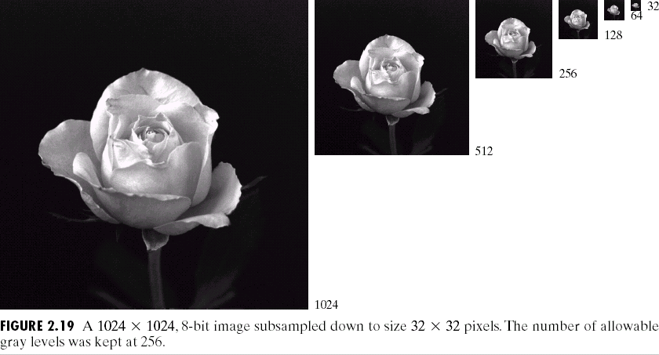
Spatial Resolution

Slide 6
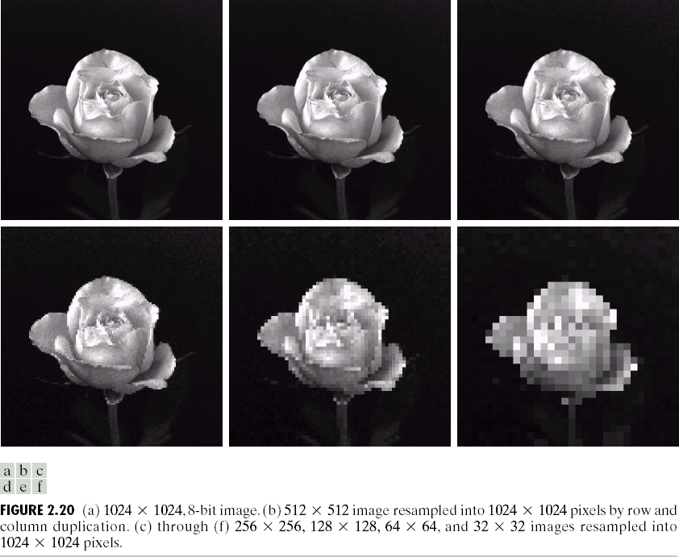
Effects Reducing Spatial Resolution

Slide 7
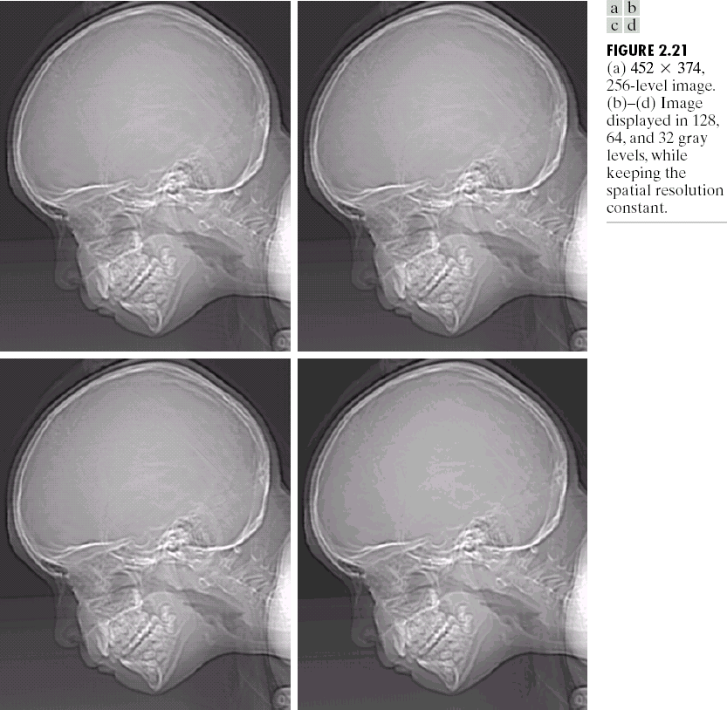
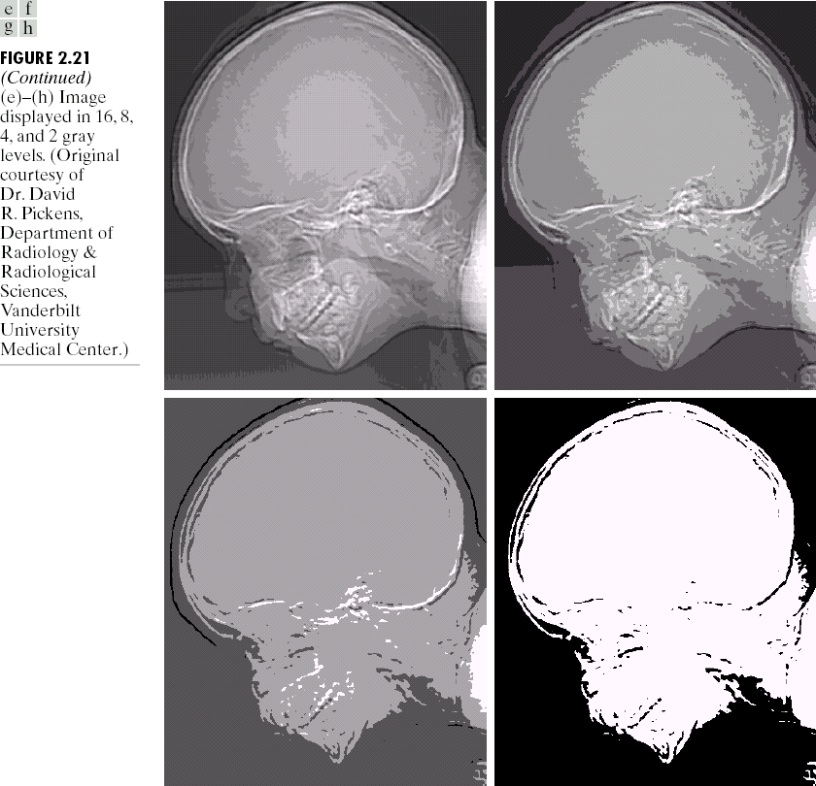
Gray Level Resolution

Slide 8
Image Interpolation
Interpolation — Process of using known data to estimate unknown values
e.g., zooming, shrinking, rotating, and geometric correction
Interpolation (sometimes called resampling) — an imaging method to increase (or decrease) the number of pixels in a digital image.
Some digital cameras use interpolation to produce a larger image than the sensor captured or to create digital zoom

Slide 9
Zooming & Shrinking Images
Zooming an image can be achieved by
  Nearest neighbour interpolation
  Pixel replication
  Bilinear interpolation
NOTE: Once the image is digitized, there is no information available of the gray level values between two pixels in the image.
Shrinking the image can be achieved by
  Subsampling the image
  Row-column deletion

Slide 10


Examples
row
column
f(m,n)
g(m,n)
EE465: Introduction to Digital Image Processing
15

Slide 11
Examples
a
b
c
d
zero-order
first-order
a | a | b | b
a | a | b | b
c | c | d | d
c | c | d | d
a (a+c)/2 c
(a+b)/2 b (a+b+c+d)/4 (b+d)/2 (c+d)/ d
EE465: Introduction to Digital Image Processing
16

Slide 12
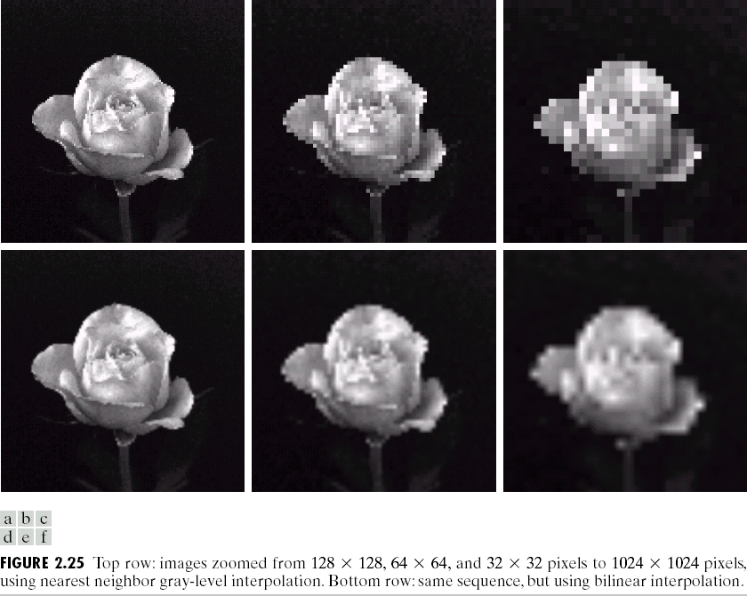
Zooming & Shrinking Images

Slide 13
Pixel Neighborhood
A pixel p at coordinates (x,y)
  Has four horizontal and vertical neighbors (x-1,y), (x+1,y) and (x,y-1), (x,y+1)
    These are called the 4-neighbors of p denoted by N₄(p)
  And four diagonal neighbors (x-1,y-1), (x+1,y+1) and
  (x- 1,y+1), (x+1,y-1)
    These are denoted by N_{D}(p)
These points together define the 8-neighbors of p (N₈(p)).

Slide 14
Connectivity of Pixels
Connectivity between pixels is a fundamental concept that simplifies the definition of regions and boundaries.
It is useful for:
  Establishing object boundaries
  Defining image components/regions.
Two pixels are connected if
  They are neighbors and
  Their gray levels satisfy a specified criterion of similarity.

Slide 15
Adjacency of Pixels
Two pixels p and q with values from set V (set of gray level values used to define adjacency) are 4-adjacent if q is in the set N₄(p).
Two pixels p and q with values from set V are 8-adjacent if
q is in the set N₈(p).
Two pixels p and q with values from set V are m-adjacent if
    q is in the set N₄(p) or
    q is in N_{D}(p) and the set N₄(p)∩N₄(q) has no pixels whose values are from V
Two image subsets S₁ and S₂ are adjacent if some pixel in S₁ is adjacent to some pixel in S_{2.}

Slide 16
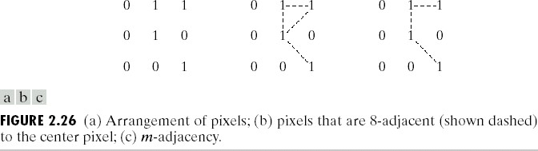
Adjacency of Pixels

Slide 17
Digital Path
A digital path or curve from pixel p with co-ordinates (x₀,y₀) to pixel q with co-ordinates (x_{n},y_{n}) is a sequence of distinct pixels with co-ordinates (x₀,y₀), (x₁,y₁),…, (x_{n},y_{n}) and pixels (x_{i},y_{i}) and (x_{i-1},y_{i-1}) are adjacent for 1 ≤ i ≤ n.
n is the length of the path.
NOTE: If (x₀,y₀) = (x_{n},y_{n}) then the path is a closed path.
We can define 4-, 8-, and m-paths based on the type of adjacency used.

Slide 18
Examples: Adjacency and Path
01,1
02,1
03,1
11,2
12,2
03,2
11,3
02,3
13,3
0 1 1
0 1 0
0 0 1
0 1 1
0 1 0
0 0 1
8-adjacent
m-adjacent
The 8-path from (1,3) to (3,3):
The m-path from (1,3) to (3,3):
(1,3), (1,2), (2,2), (3,3)
(i) (1,3), (1,2), (2,2), (3,3)
(ii) (1,3), (2,2), (3,3)

Slide 19
Connected Pixels
If S is a subset of pixels in an image, then two pixels p and q are said to be connected in S if there exists a path between them consisting entirely of pixels in S.
For any pixel p in S, the set of pixels that are connected to it in S is called a connected component of S
NOTE: If it has only one connected component, then set S
is called a connected set.

Slide 20
Image Regions & Boundaries
R (a subset of pixels in an image) is a region of the image if
R is a connected set.
The boundary (border or contour) of the region R is the set of pixels in the region that have one or more neighbors that are not in R.

Slide 21
Distance Measures
For pixels p, q and z, with coordinates (x,y), (s,t) and (v,w), respectively D is a distance function or metric if
    1. D(p,q) ≥ 0
    2. D(p,q) = D(q,p)
    3. D(p,z) ≤ D(p,q) + D(q,z)

Slide 22

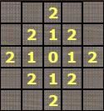
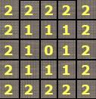
Distance Measures
Some of the distance measures that are used in image processing are
  Euclidean distance
  City-block distance or D₄ distance
– Chessboard distance or D₈ distance

Slide 23
Distance Measures
D_{m} distance between two points is defined as the shortest m-path between the points.
p3 p4
p1 p2
p

Slide 24
Image Operations on Pixels
Division
Addition
Subtraction
Multiplication
Linear and Nonlinear operations:
– H(af+bg) = aH(f) + bH(g)

Slide 25
Basic Arithmetic Operations
Operation | Definition
ADD | c = a + b
SUB | c = a - b
MUL | c = a * b
DIV | c = a / b
LOG | c = log(a)
EXP | c = exp(a)
SQRT | c = sqrt(a)
TRIG. | c = sin/cos/tan(a)
INVERT | c = (2^{B} - 1) - a

Slide 26
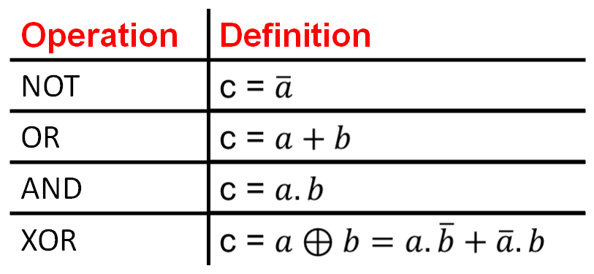
Basic Logical Operations

Slide 27





a
b
NOT(a)
a . b
a + b

Slide 28
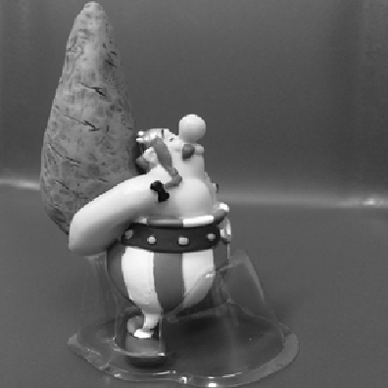

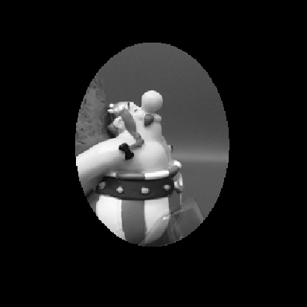

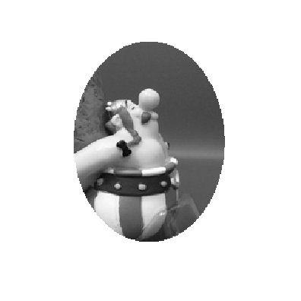
Arithmetic and Logic Operations
.
=
+
=

Slide 29
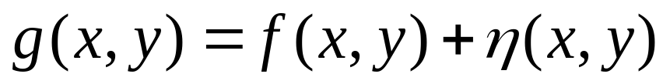
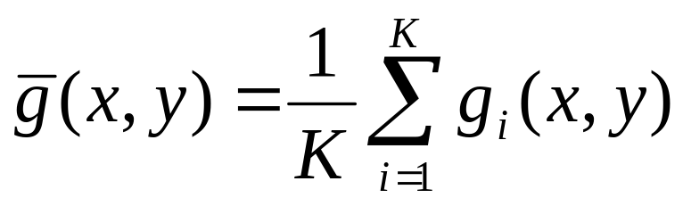
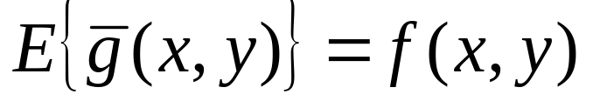
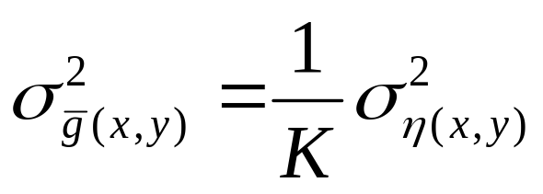
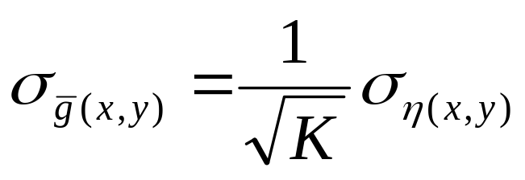
Image Averaging
  Averaging K different noisy images

Slide 30
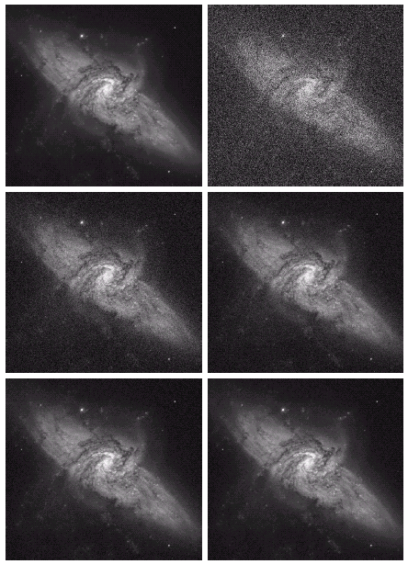
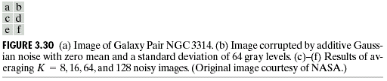
Image Averaging
Original
K=1
K=8
K=16
K=64
K=128
© 2002 R. C. Gonzalez & R. E. Woods

